Slide 1

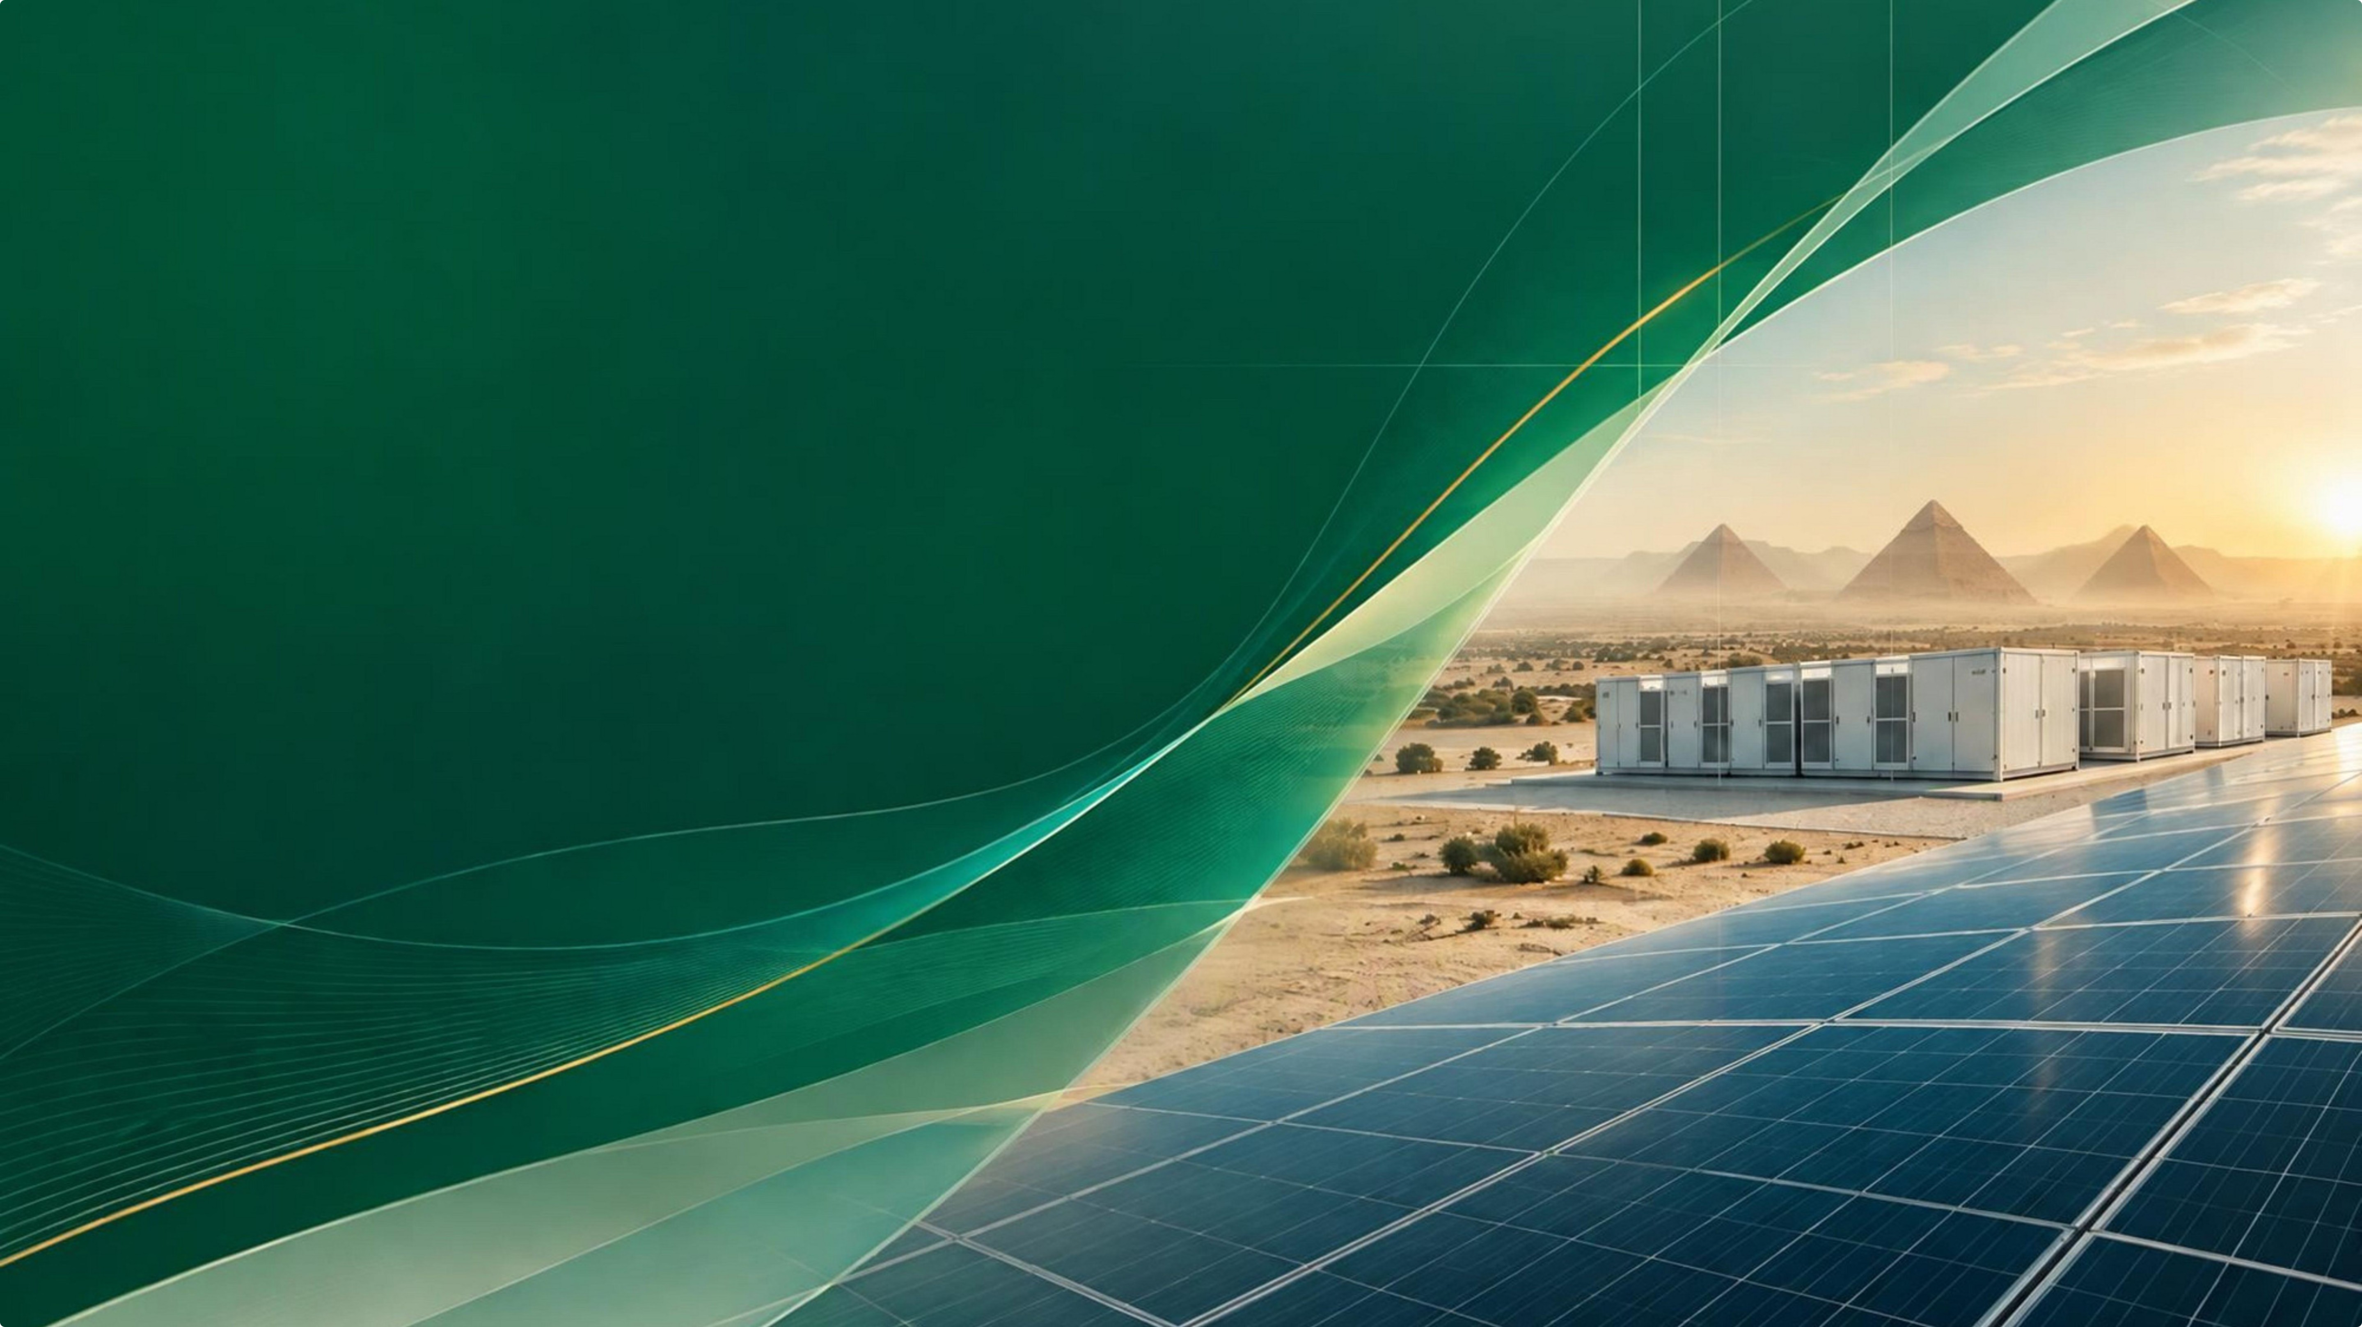


Reservia
INTEGRATED ENERGY SOLUTIONS
GENERATE | STORE | OPTIMIZE | SUSTAIN
www.reservia-energy.com

Slide 2
RESERVIA INTEGRATED ENERGY SOLUTIONS
PROFILE
Company profile
Reservia Integrated Energy Solutions is an Egyptian energy-infrastructure company with a technology-enabled, customer-focused approach, bringing engineering, project delivery and energy optimization into a connected service model.
OUR VALUES
Safety First
Customer Value
Quality & Engineering Excellence
Integrity & Accountability
Innovation & Technology
Sustainability

Slide 3
RESERVIA INTEGRATED ENERGY SOLUTIONS
VISION · MISSION · AMBITION
Our direction
A clear ambition guides how we build capability, serve customers and grow responsibly.
VISION
MISSION
To become Egypt’s leading technology-enabled energy infrastructure company and a trusted energy partner across the region, making clean, reliable, safe and affordable energy solutions accessible to businesses, industries and communities.
To design, engineer, deliver and operate integrated energy solutions that make clean, reliable, safe and affordable energy accessible, while reducing energy costs and carbon emissions, strengthening business continuity and creating lasting value.

Slide 4
RESERVIA INTEGRATED ENERGY SOLUTIONS
Our 2030 ambition
By 2030, Reservia aims to establish itself as a leading integrated energy and energy-infrastructure company in Egypt, with a growing regional presence and solutions spanning renewable energy, storage, smart energy and lifecycle services.
MARKET
ENERGY
CUSTOMERS
A proven Egyptian platform with disciplined regional growth.
Renewable generation and storage capacity deployed.
A diversified base across residential, commercial, industrial and energy-intensive sectors.
TECHNOLOGY
LIFECYCLE
IMPACT
Digital monitoring, control and energy optimization across assets.
A growing base of O&M, monitoring and asset services.
Measurable progress on energy cost and carbon emissions.

Slide 5
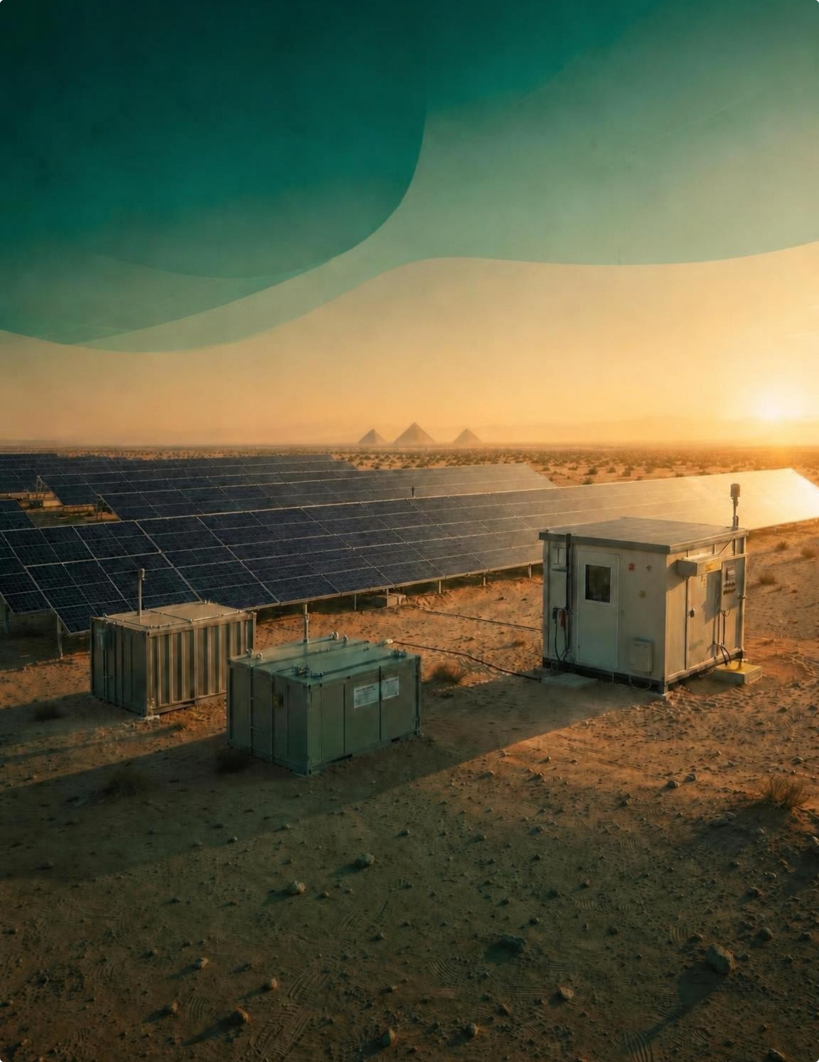
RESERVIA INTEGRATED ENERGY SOLUTIONS
THE RESERVIA MODEL
Energy, considered as a whole
Reservia brings generation, storage, smart controls and lifecycle support together around each customer’s needs.
Egyptian energy-infrastructure company with a technology-enabled, customer-focused approach.

Slide 6




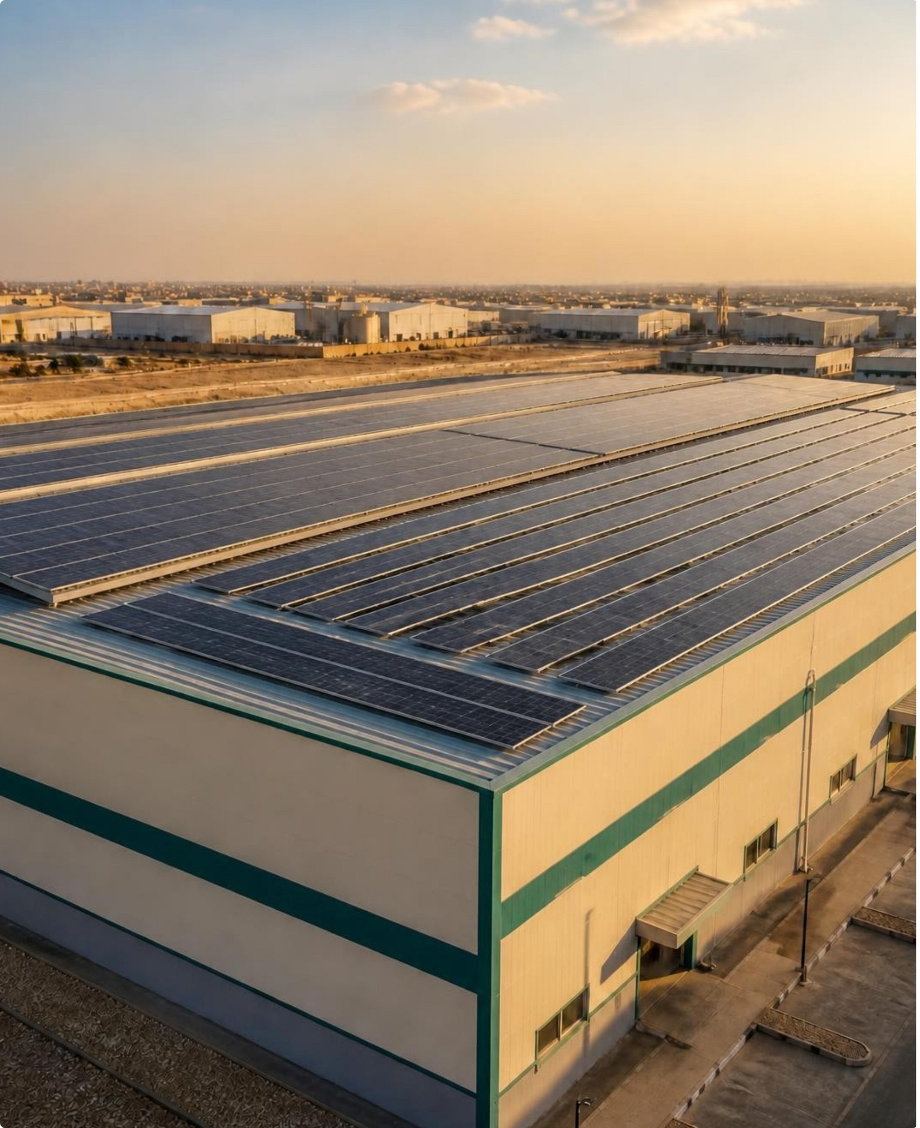








RESERVIA INTEGRATED ENERGY SOLUTIONS
ONE CONNECTED MODEL
Generate | Store | Optimize | Sustain
One connected model for building cleaner, more reliable and more manageable energy systems.
Generate
Store
Renewable energy, led today by solar.
Flexibility, reliability and continuity.
Optimize
Sustain
Monitoring and intelligent controls.
Operations, maintenance and improvement.

Slide 7








RESERVIA INTEGRATED ENERGY SOLUTIONS
THE PLATFORM
Five pillars, one platform
Integration is the advantage: each capability supports the next across the asset lifecycle.
Renewable energy
Storage & resilience
Smart energy
EPC & energy infrastructure
Sustainability & lifecycle services

Slide 8

























































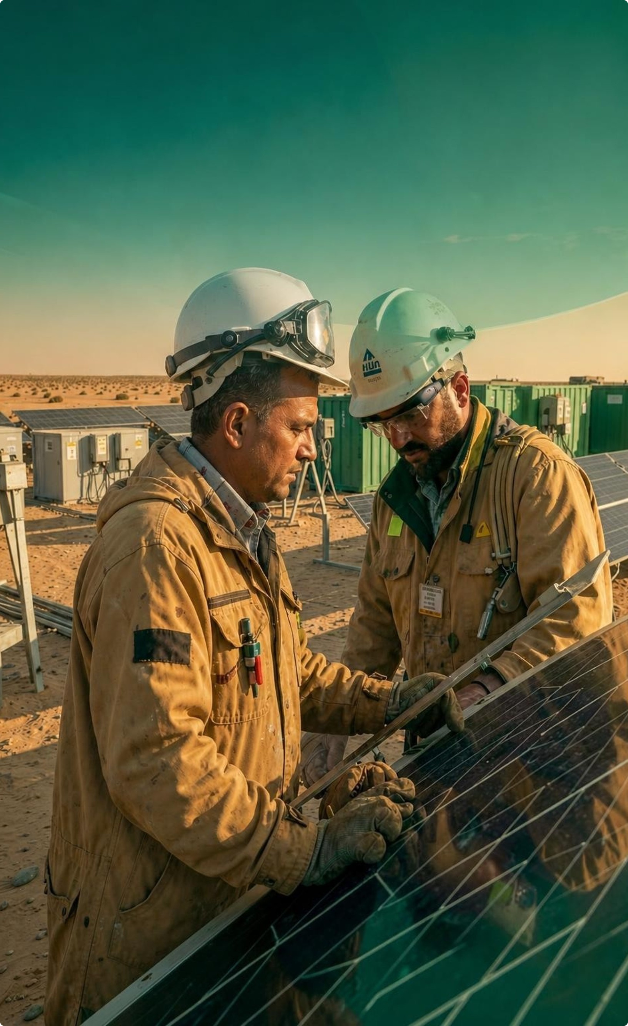
RESERVIA INTEGRATED ENERGY SOLUTIONS
THE DELIVERY PATH
From the first question to delivered asset
A disciplined path keeps scope, assumptions and decisions visible from discovery to operation.
Discover objectives and constraints
Assess data, site and suitability
Design technical options and scenarios
Structure commercial pathways and delivery scope
Deliver procurement, construction, integration and commissioning
Operate & improve through monitoring and maintenance

Slide 9





RESERVIA INTEGRATED ENERGY SOLUTIONS
START WITH THE SITE
Services that start with the site
The final design reflects the site, customer objectives, applicable requirements and agreed scope.
Energy needs assessment and site survey
Feasibility, concept and detailed engineering
Yield and performance modeling
Technical and commercial evaluation
Permitting and interface coordination

Slide 10



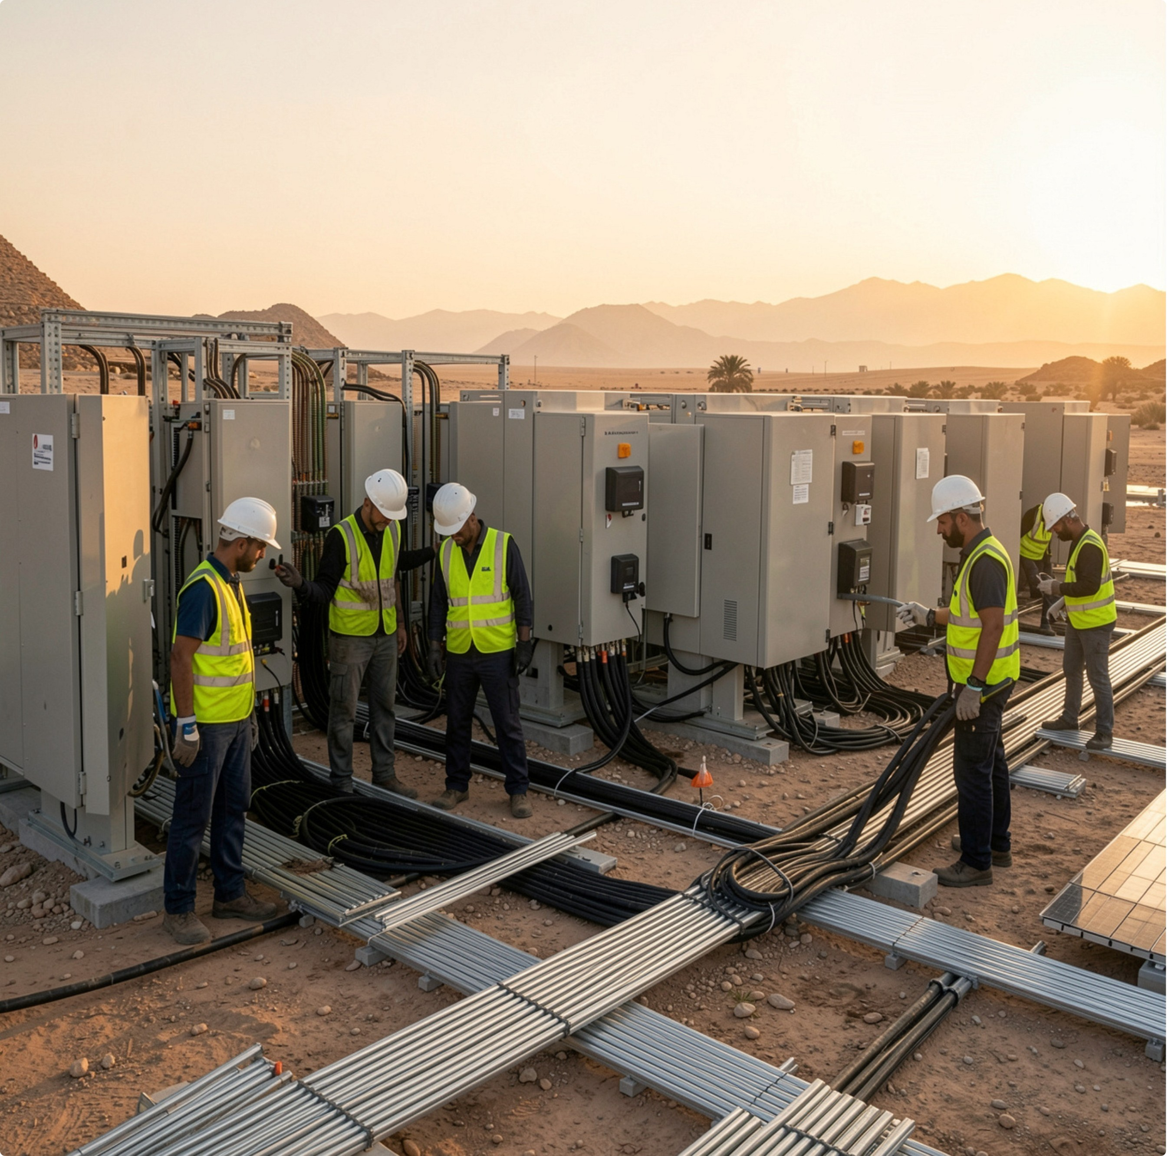
RESERVIA INTEGRATED ENERGY SOLUTIONS
DELIVERY TO HANDOVER
Delivery that becomes a working system
Procurement, construction, electrical integration, testing, commissioning and handover are coordinated against the approved design.
Safety and quality stay embedded
Handover supports the customer team
Across design, procurement, construction, commissioning and operations.
Documentation, operating guidance and training complete the transition.

Slide 11







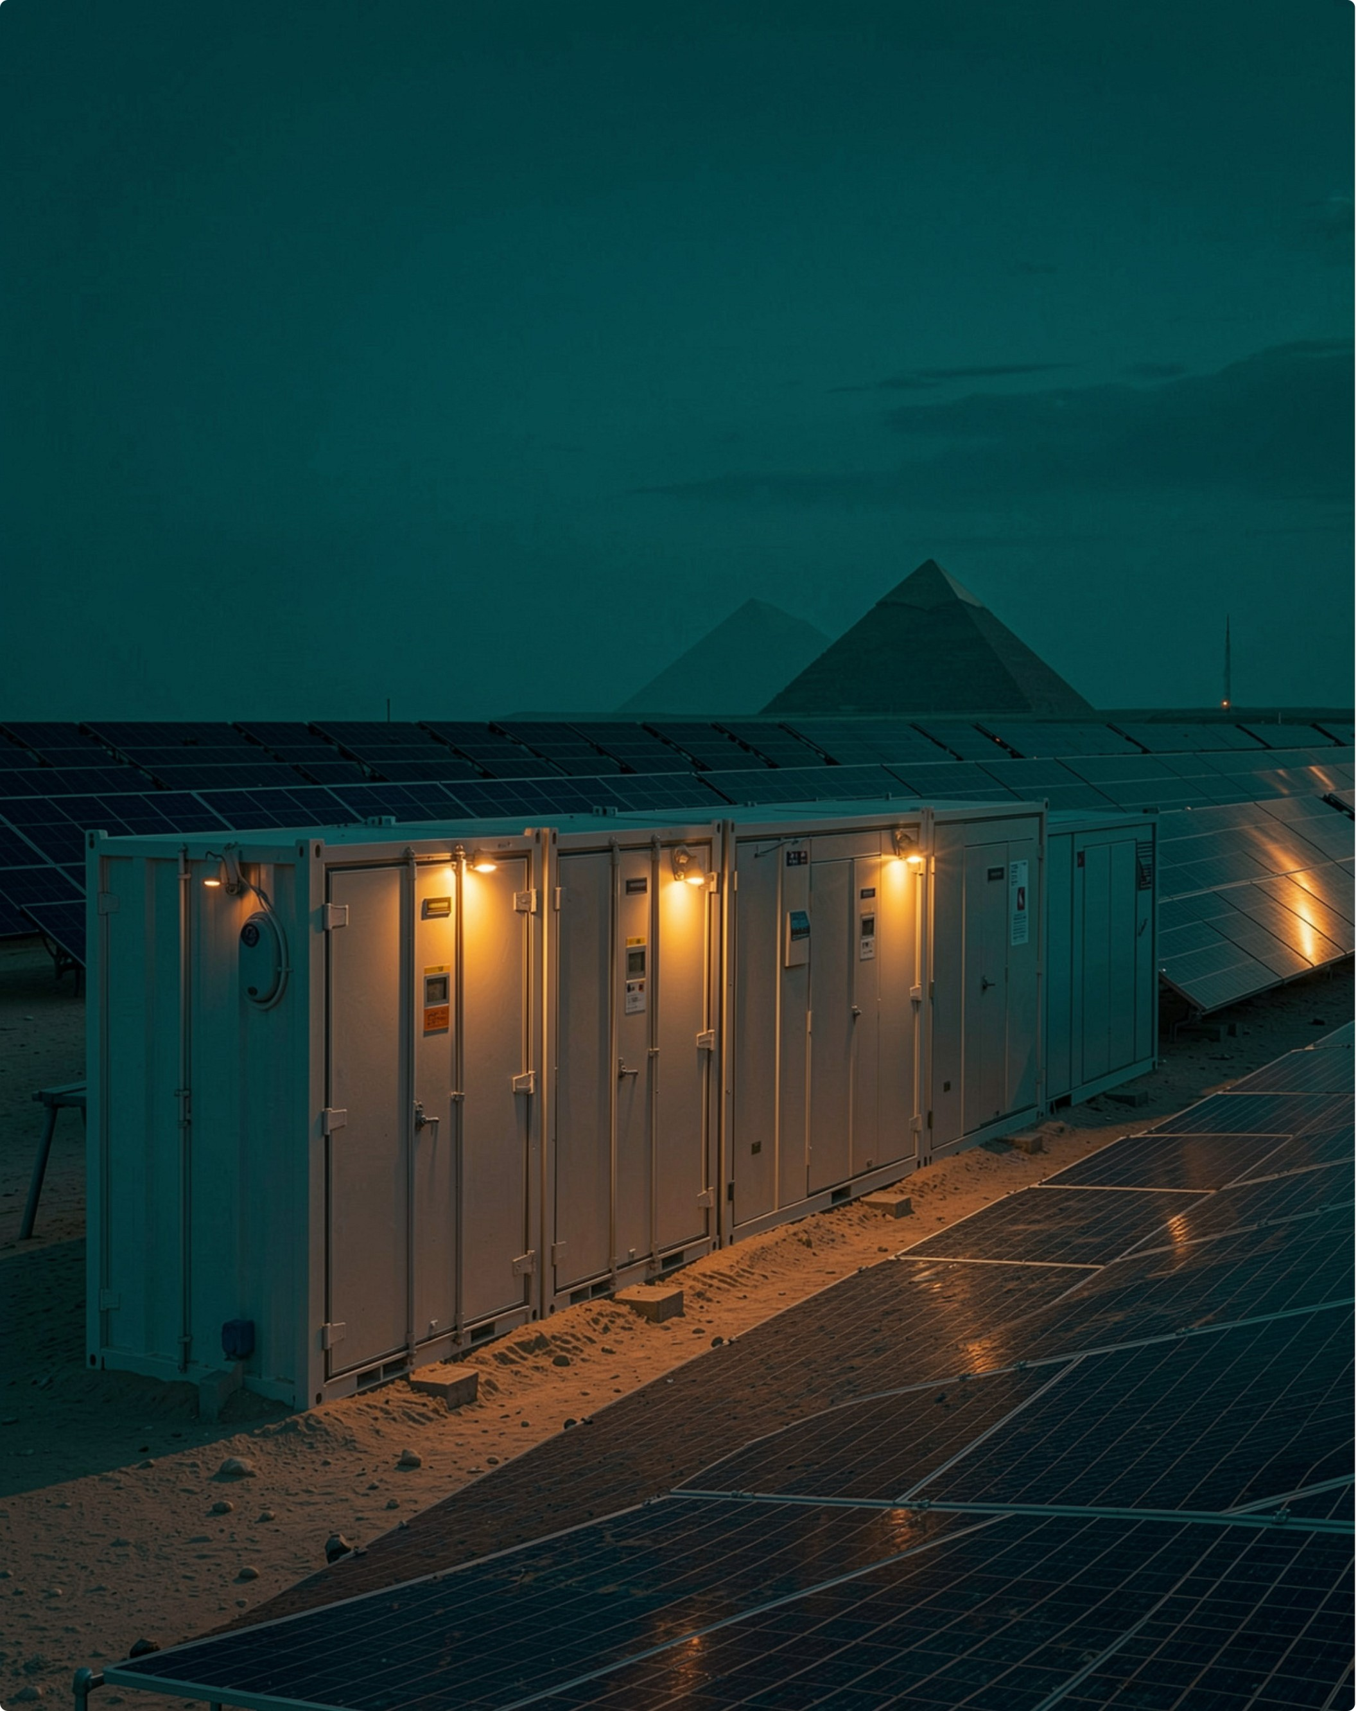




RESERVIA INTEGRATED ENERGY SOLUTIONS
BEYOND DAYLIGHT
Energy that works beyond daylight
Align
Protect
Storage aligns clean generation with changing demand and operating priorities.
Resilience planning considers backup, continuity needs and critical loads.
See
Decide
Monitoring and control improve visibility across generation, storage and consumption.
Optimization turns available data into better operating decisions.

Slide 12






RESERVIA INTEGRATED ENERGY SOLUTIONS
WHERE IT WORKS
Solutions across sectors
Residential & home compounds
Hotels & hospitality
Commercial buildings and services
Industrial and energy-intensive operations
Agriculture, irrigation and pumping
Schools, healthcare, community and public facilities

Slide 13






























































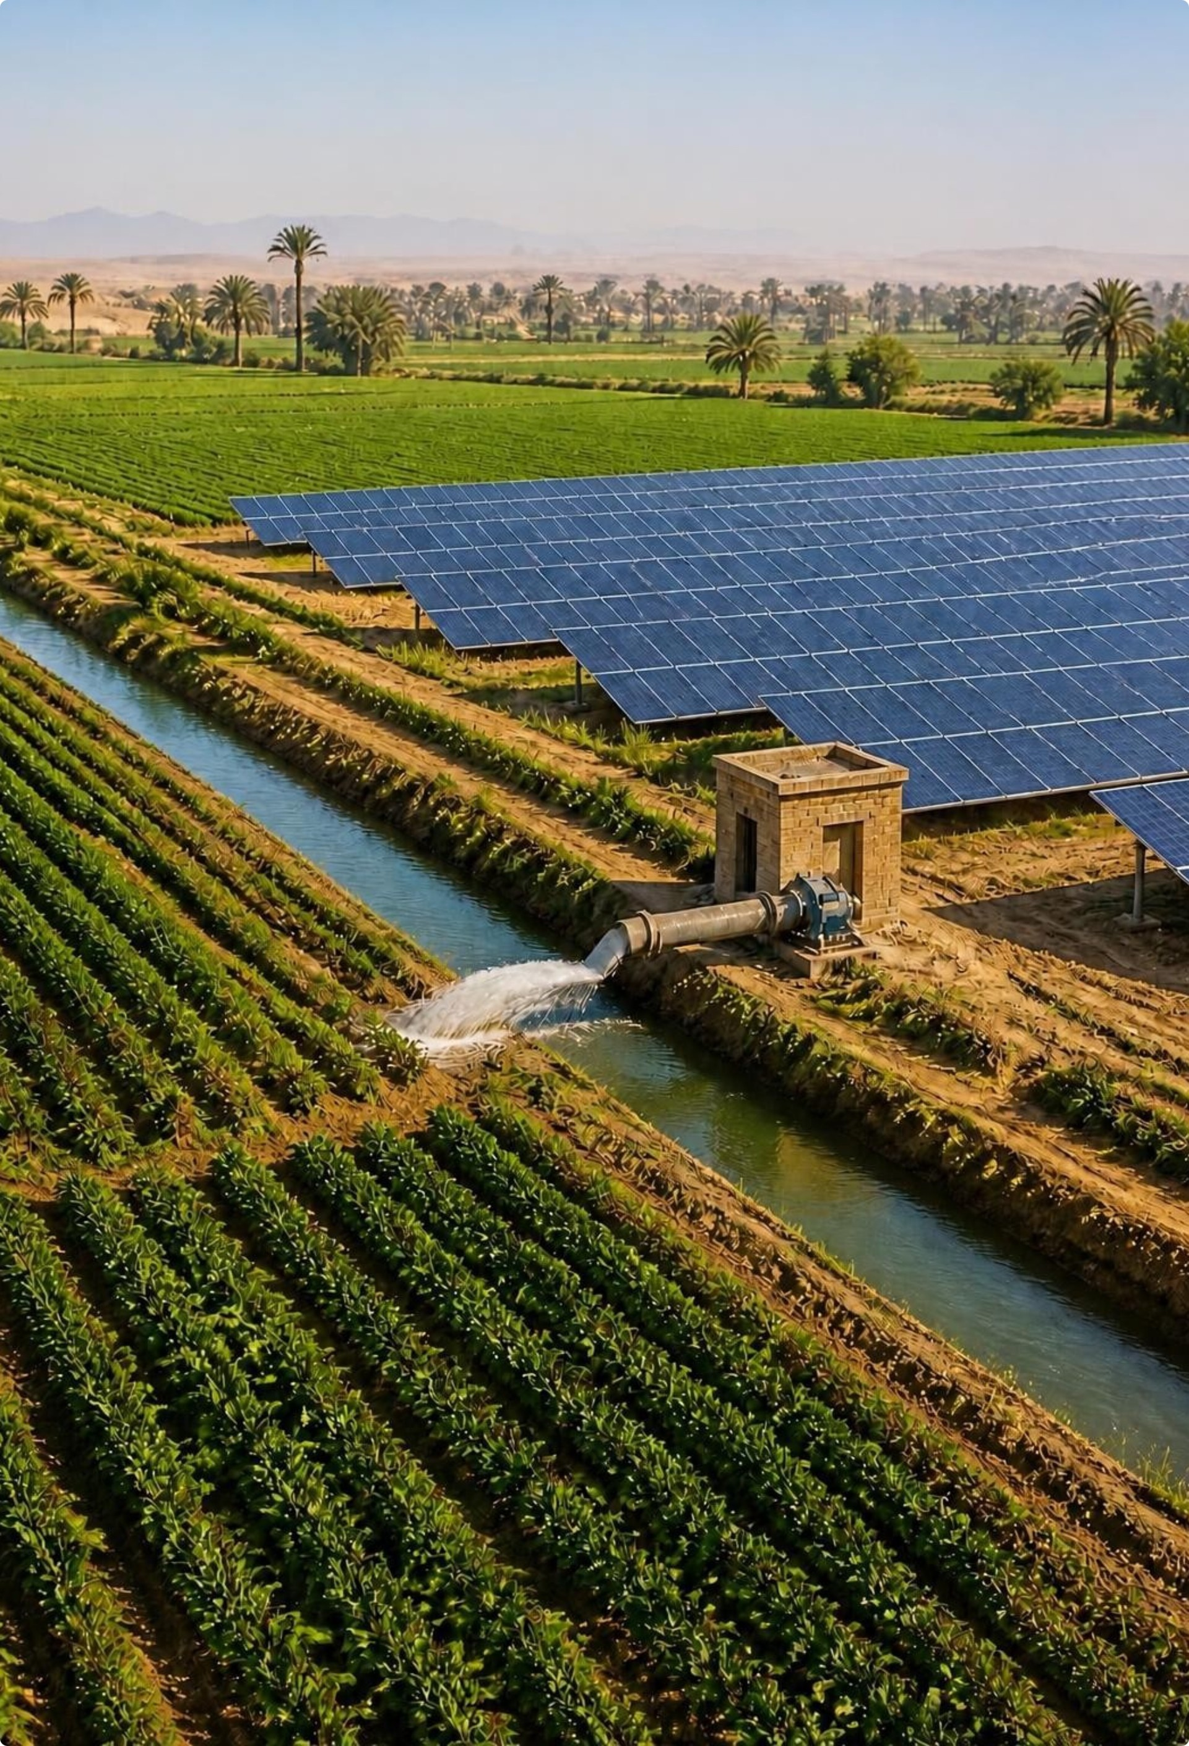




RESERVIA INTEGRATED ENERGY SOLUTIONS
THE VALUE OF INTEGRATION
Why integrated energy creates value
Manage energy costs
Reduce operational emissions
Improve resilience
With storage and control strategies.
Through on-site generation aligned with demand.
Associated with grid electricity.
Strengthen energy visibility
Create long-term value
Through monitoring.
Through lifecycle care.
Benefits depend on the site, load profile, tariffs, system design and project economics.

Slide 14
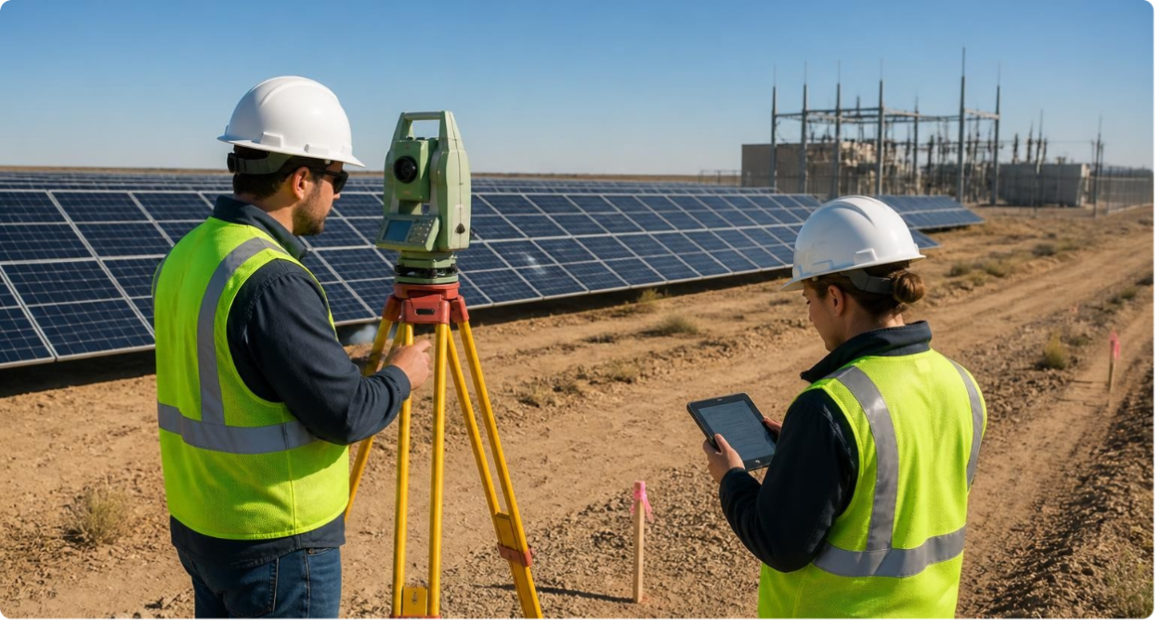
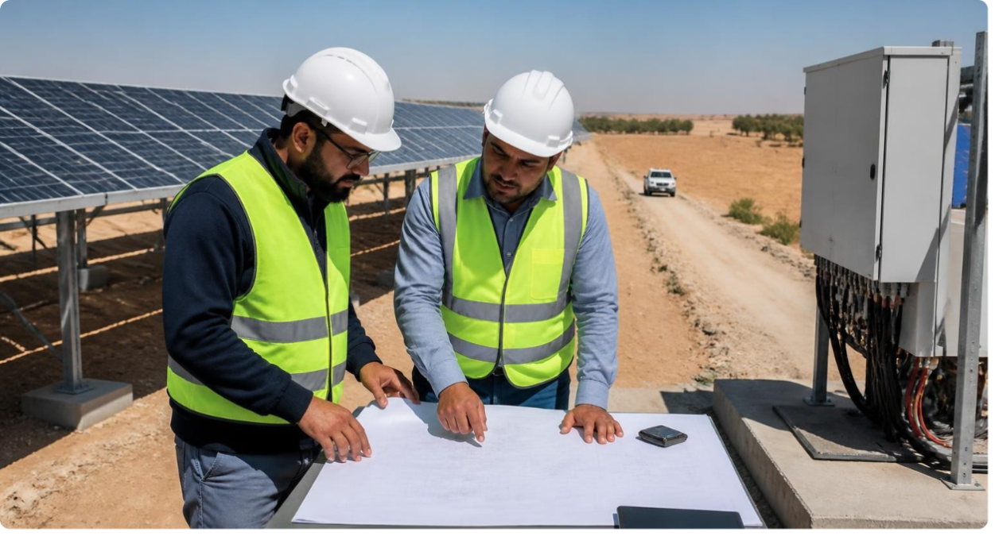
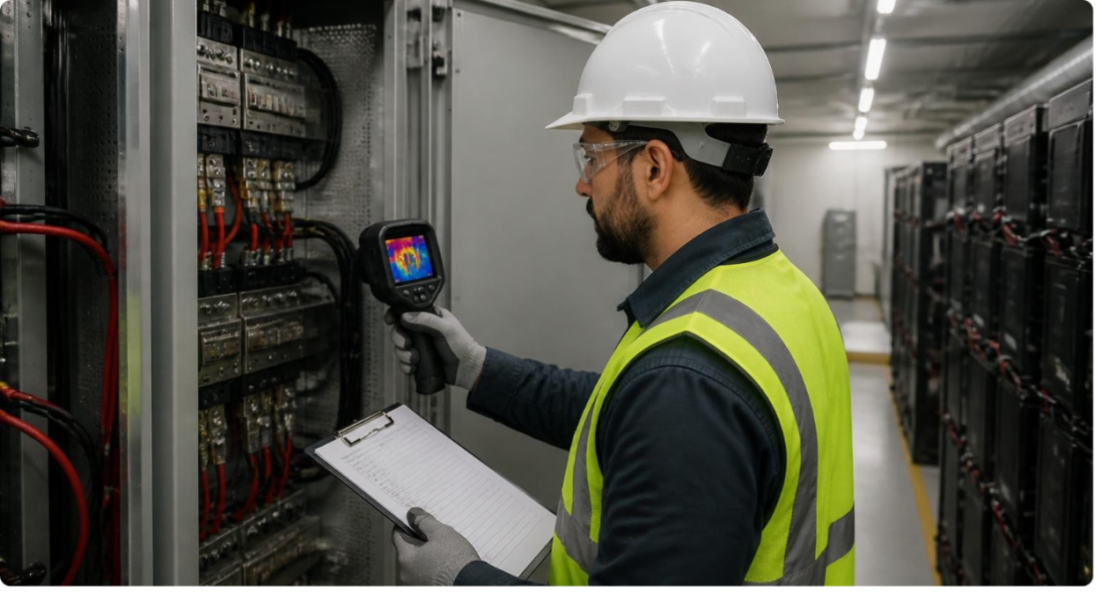
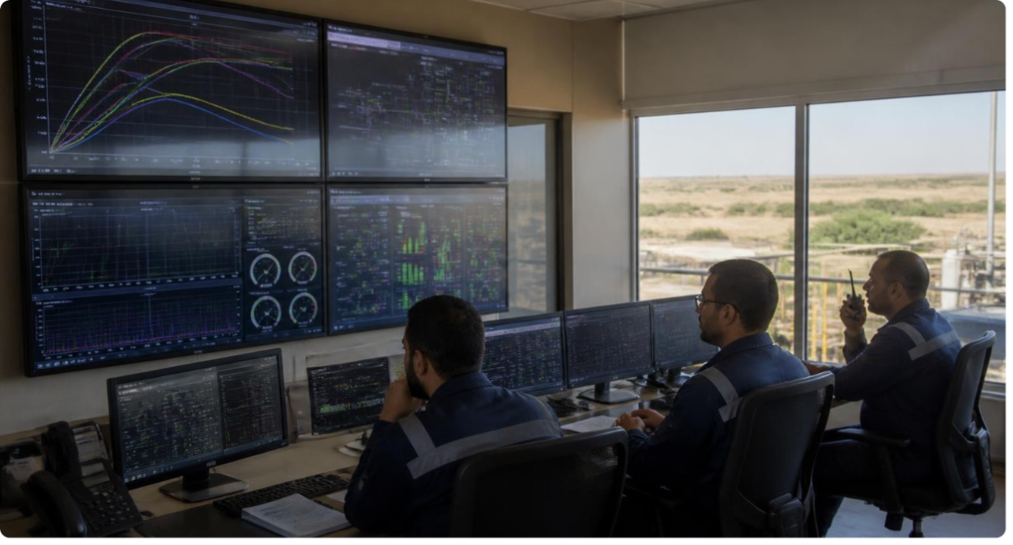
RESERVIA INTEGRATED ENERGY SOLUTIONS
OUR QUALITY COMMITMENT
Quality built into the lifecycle
Safety first
Quality and engineering excellence
Environmental responsibility
Compliance and integrity
Customer commitment
People and improvement
QHSE is embedded across the lifecycle: design → procure → construct → commission → operate.
Technical measurement
Teamwork
Quality assurance
Performance monitoring

Slide 15






RESERVIA INTEGRATED ENERGY SOLUTIONS
CONTACT RESERVIA
Let’s plan your next energy step
Start with the site, the energy challenge and the outcome you want to achieve.
Reservia Integrated Energy Solutions
Elite Tower | 3rd Floor | Unit M-19-3
Zahraa El Maadi Entrance
Cairo | Egypt
+20 121 189 2995
+20 2 2522 2814
INTEGRATED ENERGY SOLUTIONS
Business_info@reservia-energy.com
www.reservia-energy.com

